Slide 1
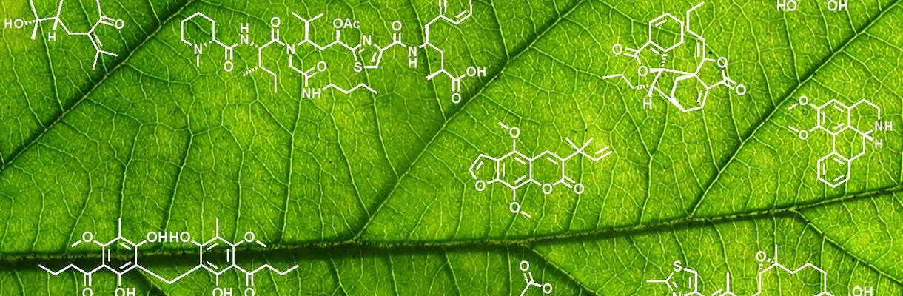
Service A
API
Web Service
Service B
How software architecture defines boundaries and APIs bridge them
Fabian Mauz

Slide 2
How software architecture defines boundaries and APIs bridge them
What is software architecture?
The software architecture of a program or computing
system is the structure or structures of the system,
which comprise software components, the externally
visible properties of those components, and the relationships
among them
[1]
„The goal of software architecture is to minimize the human resources required to build and maintain the required system“
Robert C. Martin, Clean Architecture, 2017
„Software architecture is those decisions which are both important and hard to change “
Martin Fowler
„Architecture represents the significant design decisions that shape a system, where significant is measured by cost of change “
Grady Booch
[1] L. Bass, P. Clements and R. Kazman. Software Architecture in Practice. Addison Wesley, 1999, ISBN 0-201-19930-0.

Slide 3
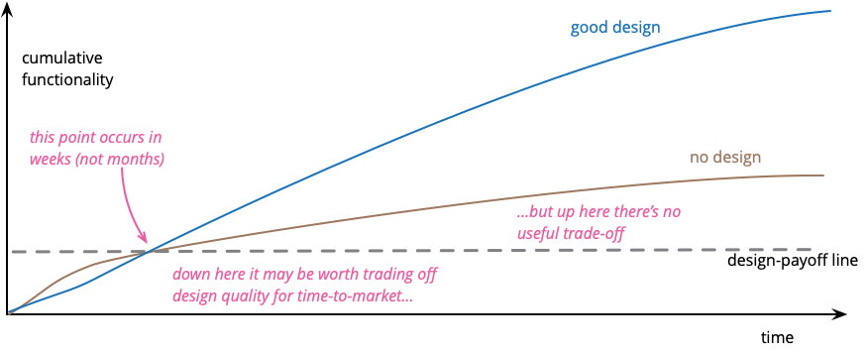
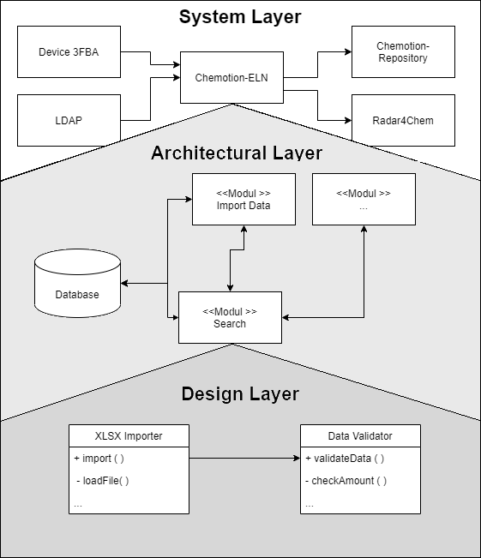

Sustainable software development / chapter 1
Why think about architecture?
System $≠Architecture ≠$ Design ???
M. Fowler, Design Stamina Hypothesis, 2007

Slide 4

Sustainable software development / chapter 1
Dependencies
One main problem to change software are dependencies
Data Provider A
UniProtKB
Query: EC 1.1.1.1
Algorithm A
Data Provider B
ENZYME
How difficult is it to change the data provider ???

Slide 5
Sustainable software development / chapter 1
Coupling
One main problem to change software are dependencies
Data Provider A
UniProtKB
Query: EC 1.1.1.1
Algorithm A
Data Provider B
ENZYME
Loose Coupling
Interfaces
APIs
Content
Domain
Boundries
Datastructure
Function calls

Slide 6
Sustainable software development / chapter 1
Microservice architecture
Small independent, specialized services
Own isolated data persistence
Communication takes place via well-defined APIs
UI
Service 1
Service 2
The good
The bad
„Small“ codebase, can be implemented independently
High scalability
Technological flexibility
Reliability
More complex than monolith
Deployment more complex
Data Consistency
Communication slower
DB 1
Service 3
DB 2
O.Al-Debagy, P.Martinek, A Comparative Review of Microservices and Monolithic Architectures, 2018

Slide 7

Sustainable software development / chapter 1
Microservice architecture – Examples
Service 1
Service 3
Service 2
https
Reverse Proxy
User
Backend
JDBC
Chemical aware Postgres
Webfrontend
REST
REST
Service n+1
Service n
Calculation/Predicting
Service

Slide 8
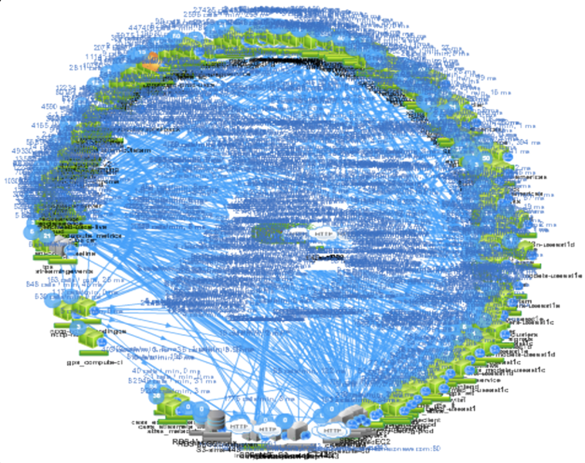
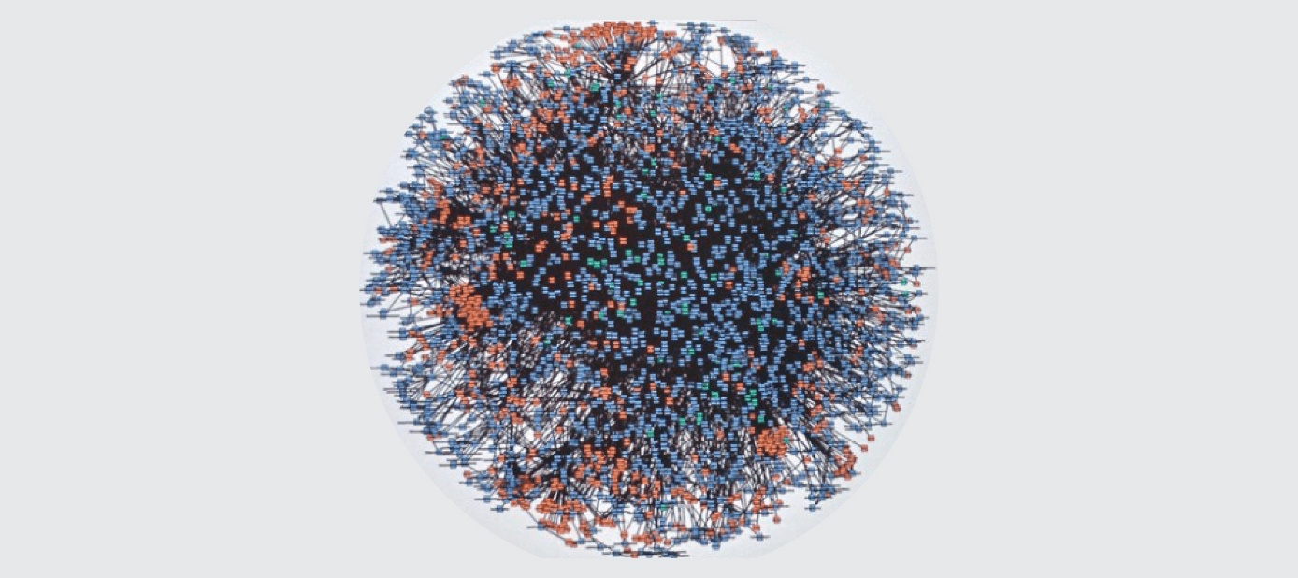
Sustainable software development / chapter 1
Microservice architecture – Examples - Netflix & Amazon
^{Amazon, 2000 [4]}
„Microservices and serverless components are tools that do work at high scale, but whether to use them over monolith has to be made on a case-by-case basis”
Netflix-Death-Star Architecture[4]
Amazon claims to have reduced the cost of its video streaming service by 90% by switching from a microservice architecture to a monolith
Marcin Kolney, Amazon Prime Senior Software Development Engineer

Slide 9
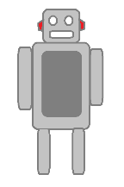
Sustainable software development / chapter 1
Ports and Adapters/Hexagonal architecture
ENZYME
ML – Tool 1
Adapters
ML – Tool 2
REST
Port
REST
Project DB
JPA
Core Ideas
Port
Port
REST
Application
Business logic is isolated from infrastructure
Changing infrastructure does not effect BL
Infrastructure and BL communicate with ports and adapters (loose coupling)
Primary (triggers an usecase) and Secondary Actors
Port
UI
Test
User
https://alistair.cockburn.us/hexagonal-architecture/, 2005

Slide 10
Sustainable software development / chapter 1
Ports and Adapters – Example
UseCase : Search for molecule with substructure search
User
Postgres
REST
JPA
TEST
Port
Port
UseCase

Slide 11
Sustainable software development / chapter 1
Ports and Adapters – Example
UseCase : Search for molecule with substructure search
User
Postgres
<< REST >>
MoleculeSearch
<<Class>>
MoleculeSearchService
<< Junit >>
MoleculeSearchServiceTest
uses
<< Interface >>
MoleculeSearchPort
<< Interface >>
MolecularSearchRepositoryPort
implements
implements
uses
<< class >>
MolecularSearchUseCase

Slide 12
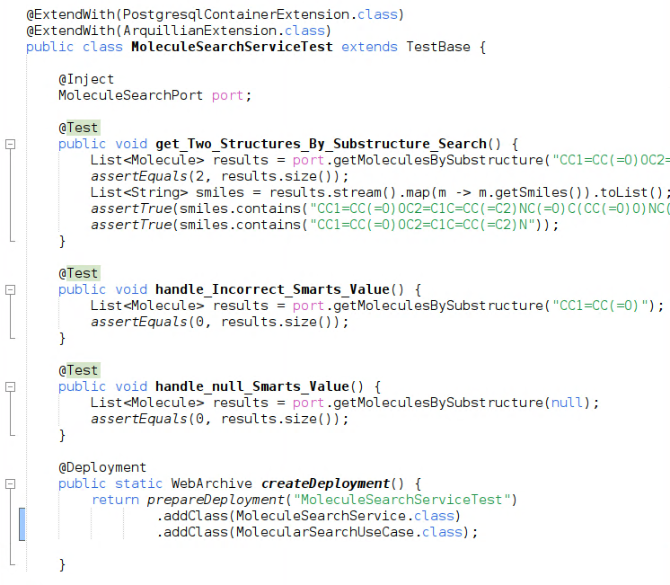
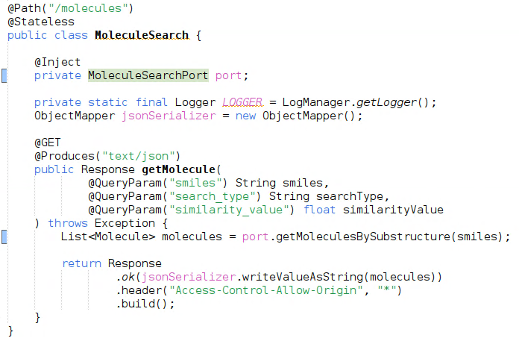






Sustainable software development / chapter 1
Ports and Adapters – Example
Adaper – Junit Test
Adaper – REST

Slide 13
Sustainable software development / chapter 1
API – A practical definition
Both architectures define boundries
Adapters and application are
conceptually separated from each other
Services are conceptually and often physically separated from each other
Can we find a definition that does justice to both
??
Service
Service
Service
Communication over a function call defined by an interface
Communication over a network based protocol like REST or JDBC

Slide 14
Sustainable software development / chapter 1
API – A practical definition
API – Application programming interface
Both represent an abstraction of the underlying implementation
Both introduces a specification of types or data needed or delivered
Both defines a semantic or behaviour of exchange
Domain
Signature
Service
Service
Protocoll
Service
J. Gough, D Bryant, M Auburn, Mastering API Architecture,2023, S. XXV

Slide 15
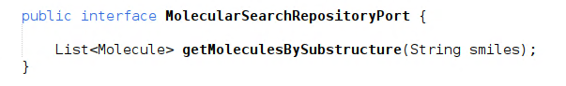
Sustainable software development / chapter 1
API - Java function call defined by an interface
The keywords and the environment (java) defines the protocol
The naming of the method and parameters indicates it‘s functionallity
Protocol
Domain
There is no statement about how something is done only what
There is no indication of whether the request is idempotent, so it always returns the same response each time it is called (This can be defined in part by the protocol type)
Signature
The method name,input and output arguments and their types

Slide 16
Sustainable software development / chapter 1
API – REST Definition
REST : Representational State Transfer
Not a standard or protocol, like HTTP but more of a style
Protocol: Not strictly defined but in reality 99% http(s)
Set of rules/constraints
Client-server
Stateless systems
Cache
Uniform interface
Layered system
Code on demand
Domain: domain specific resources
Signature: Query parameters, server address+path and Response
There are different levels of REST
R. Fielding, Architectural Styles and the Design of Network-based Software Architectures,2000
M. Amundsen, Design and Build Great Web APIs, 2020

Slide 17
Sustainable software development / chapter 1
REST – some (useful?) API design patterns
Conformist pattern: the upstream party defines the parameters and the protocol. The downstream party must implement those
Anti-Corruption Layer: An adapter between the real API and the application which uses the api
Open Host Service: One or more adapter between application and different variants of the API to customize them
Shared Kernel: Upstream and Downstream share some pieces of the sourcecode(like datatypes)
G. Rhoden, API-Patterns: Shared Kernel, Anti-Corruption Layer & Co. – wie bitte?! // Deutsch, 2024, [https://www.youtube.com/watch?v=n47RSfeFIy8]

Slide 18
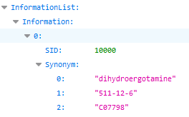
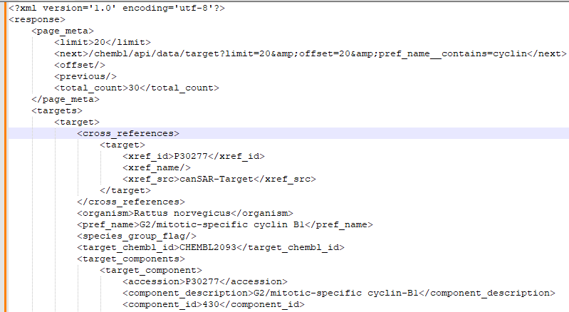
Sustainable software development / chapter 1
API – REST Example - Browser
pubchem - searching for synonyms
https://pubchem.ncbi.nlm.nih.gov/rest/pug/substance/sid/10000/synonyms/json
protocol
server
path
ChEMBL - searching for molecules with name pattern
https://www.ebi.ac.uk/chembl/api/data/target?pref_name__contains=cyclin
protocol
server
path
parameter
https://pubchem.ncbi.nlm.nih.gov/docs/pug-rest-tutorial
https://www.ebi.ac.uk/chembl/ws

Slide 19
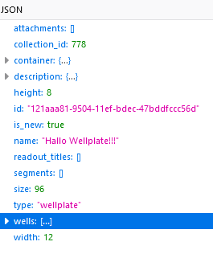
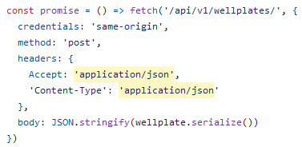
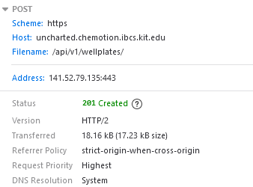
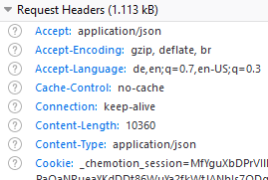
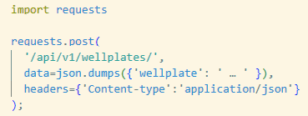
Sustainable software development / chapter 1
API – REST Example javascript and python
HTTP Request
Contains information like IP address, server, accepted data formats, …
The request method is also defined in the header
GET : Used to receive information
POST: send information to server
PUT: update information on server
DELETE: remove information on server
Request line
Header
context specific information like parameters
Message
Both create
Example java script
Example python

Slide 20

Sustainable software development / chapter 1
API – REST Example
https://pubchem.ncbi.nlm.nih.gov/rest/pug/substance/sid/10000/synonyms/json
https://www.ebi.ac.uk/chembl/api/data/target?pref_name__contains=cyclin
But how do i know what paths or parameters i have to enter ???

Slide 21
Sustainable software development / chapter 1
API – Open API
https://pubchem.ncbi.nlm.nih.gov/rest/pug/substance/sid/10000/synonyms/json
https://www.ebi.ac.uk/chembl/api/data/target?pref_name__contains=cyclin
But how do i know what paths or parameters i have to enter ???
Many but not all web services offer sufficient API documentation and they vary in form and quality
https://www.openapis.org/

Slide 22
Sustainable software development / chapter 1
API – Open API
https://pubchem.ncbi.nlm.nih.gov/rest/pug/substance/sid/10000/synonyms/json
https://www.ebi.ac.uk/chembl/api/data/target?pref_name__contains=cyclin
But how do i know what paths or parameters i have to enter ???
OpenAPI
The OpenAPI Specifications provides a formal standard for describing HTTP APIs
https://www.openapis.org/

Slide 23
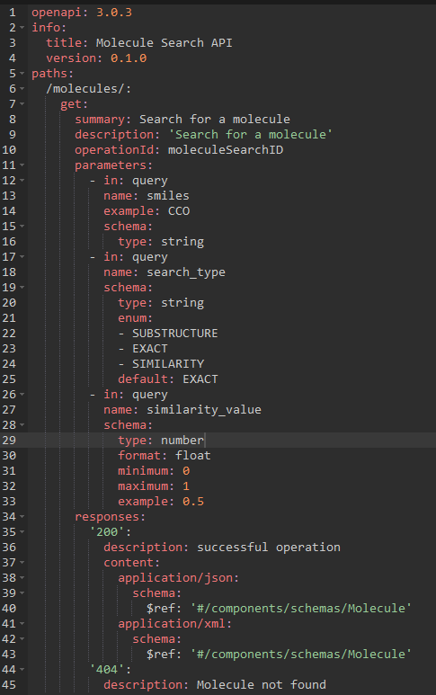
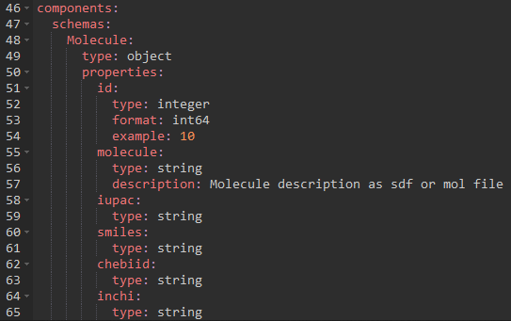
Sustainable software development / chapter 1
API – Open API Specification 3.0

Slide 24
Sustainable software development / chapter 1
API – Open API Specification 3.0
What's in here for me???

Slide 25
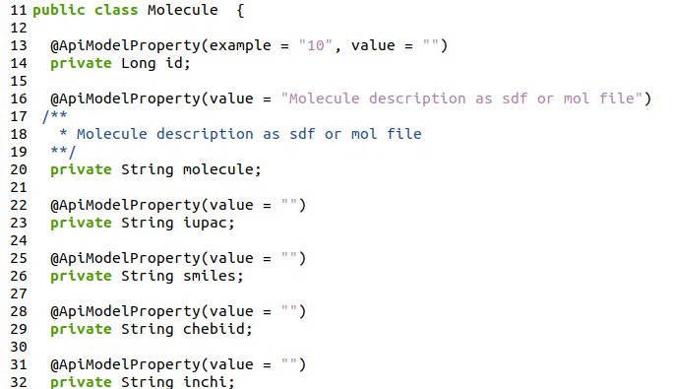
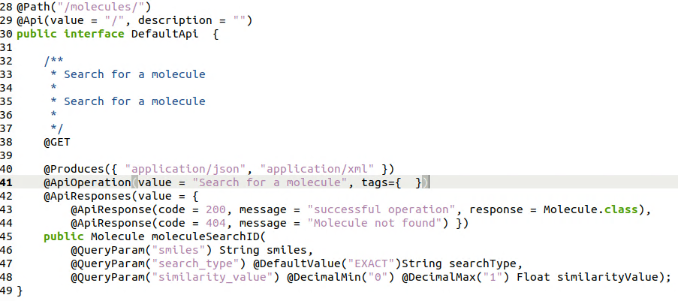
Sustainable software development / chapter 1
API – Open API – code generator
Automatic code generation
Automatic code generation for clients and servers for various languages
Automatic documentation generation for different styles
Even database shemas could be generated
Automatically generated java REST server endpoint
https://openapi-generator.tech/

Slide 26
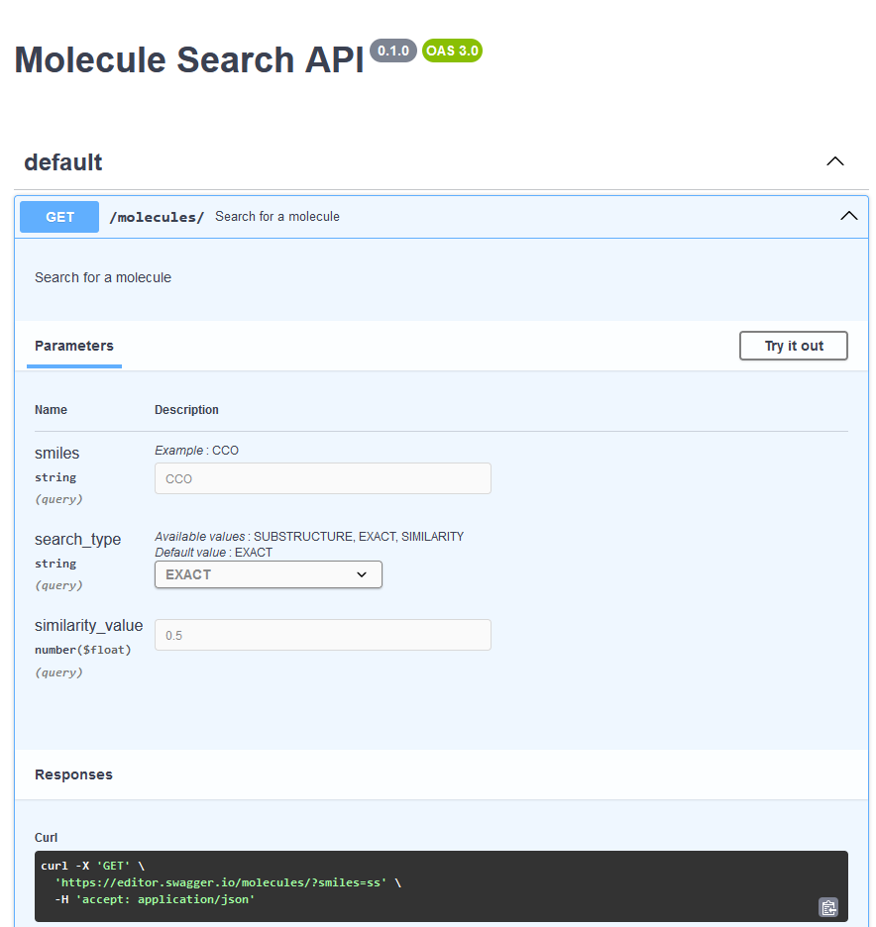
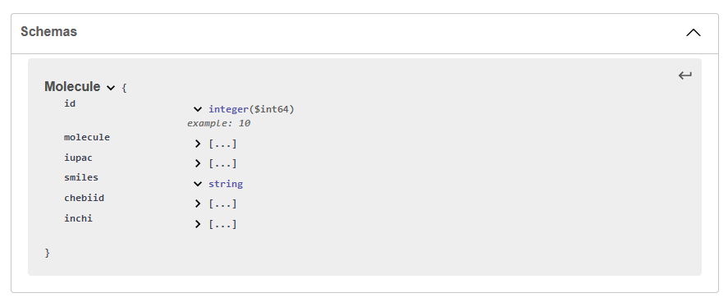
Sustainable software development / chapter 1
API – Open API – documentation
Out of the box documentation
Extensive documentation of the API routes
Detailed description of the data resources
Playground for trying out the API
Ways to simulate various security mechanisms
https://editor.swagger.io/

Slide 27
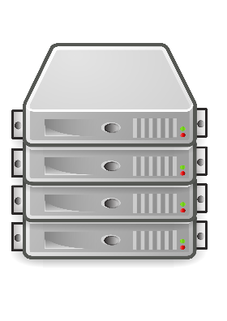
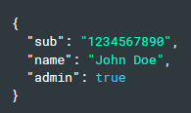
Sustainable software development / chapter 1
API – Securing API endpoints
Application
HTTP, REST
Authentification and Authorisation
Enter credentials
User
Presentation
API Access Token
API Access Token
Session
TLS
Encryption
data
…
JSON Web Token (JWT)
Compact, URL save represantation of claims between 2 parties
OSI Layer Model
xxxx.yyyy.zzzz
Authentification <> Authorisation
Header: defines type of token and signing algorithm
Payload: contains the claims
Signature: Signature for validation
Who
What
More sophisticated mechanisms:
OAuth2.0 , OpenID connect, …
M.Jones, J. Bradley,N. Sakimura, https://datatracker.ietf.org/doc/html/rfc7519, 2015
M. Amundsen, Design and Build Great Web APIs, 2020, p. 207ff

Slide 28
Sustainable software development / chapter 1
API – some tipps for API design
Tipps for a good API design
Client-server
Stateless systems
Cache
Uniform interface
Layered system
Code on demand

Slide 29
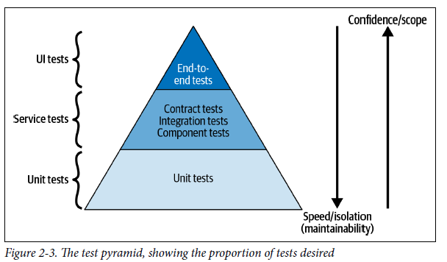
Sustainable software development / chapter 1
API – Testing of APIs
Simulates a client and a hole usecase
Frameworks: Cypress, Playwright, …
By using the Hexagon architecture, components could be mocked
Using frameworks could help: testcontainers, virtual archives, …
Usually APIs are tested in upper layers
!! All tests in all layers must be executed
automatically and must pass
regardless of environment !!
J. Gough, D Bryant, M Auburn, Mastering API Architecture,2023, S. 50

Slide 30
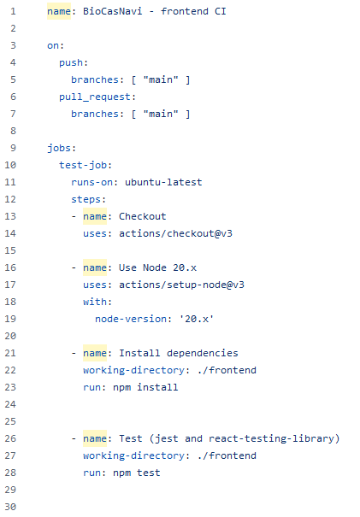
Sustainable software development / chapter 1
Testing with github actions
“… Automate, customize and execute your software development workflows directly in your repository.”
Workflow: configurable automated sequence of tasks
Event: specific occurrence in your repository that triggers a workflow
Job: collection of steps that are executed in a workflow
Action: individual building blocks of a workflow
Runner: computer on which your workflows are executed
Step: smallest executable unit in a job
https://docs.github.com/de/actions

Slide 31
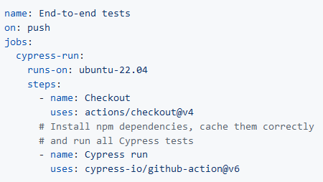
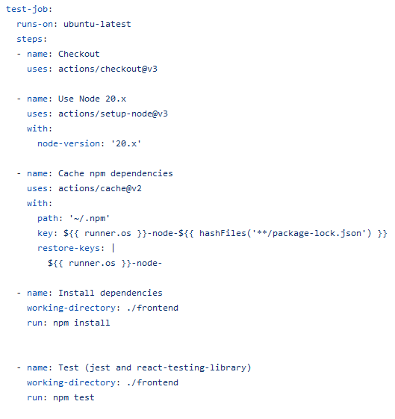
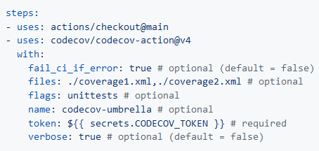
Sustainable software development / chapter 1
Github actions - examples
Hundreds of provided actions for many areas
cypress-io/github-action
codecov-action
https://github.com/sdras/awesome-actions

Slide 32
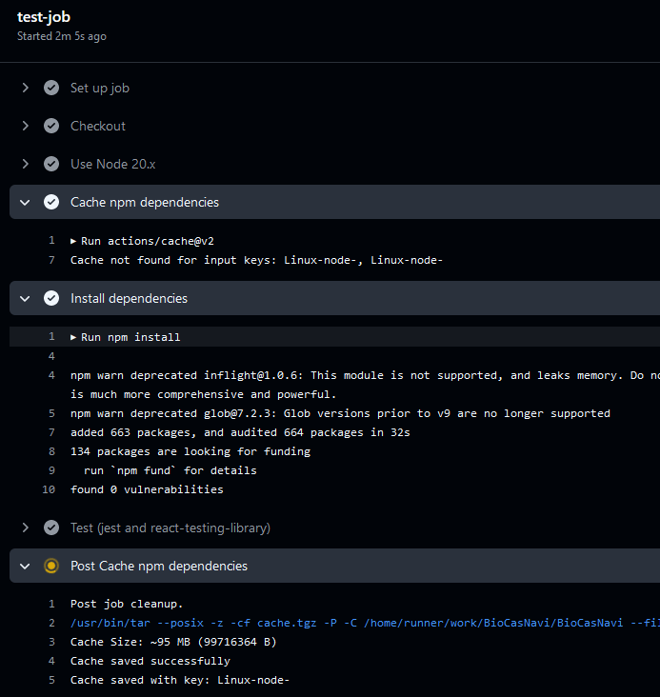
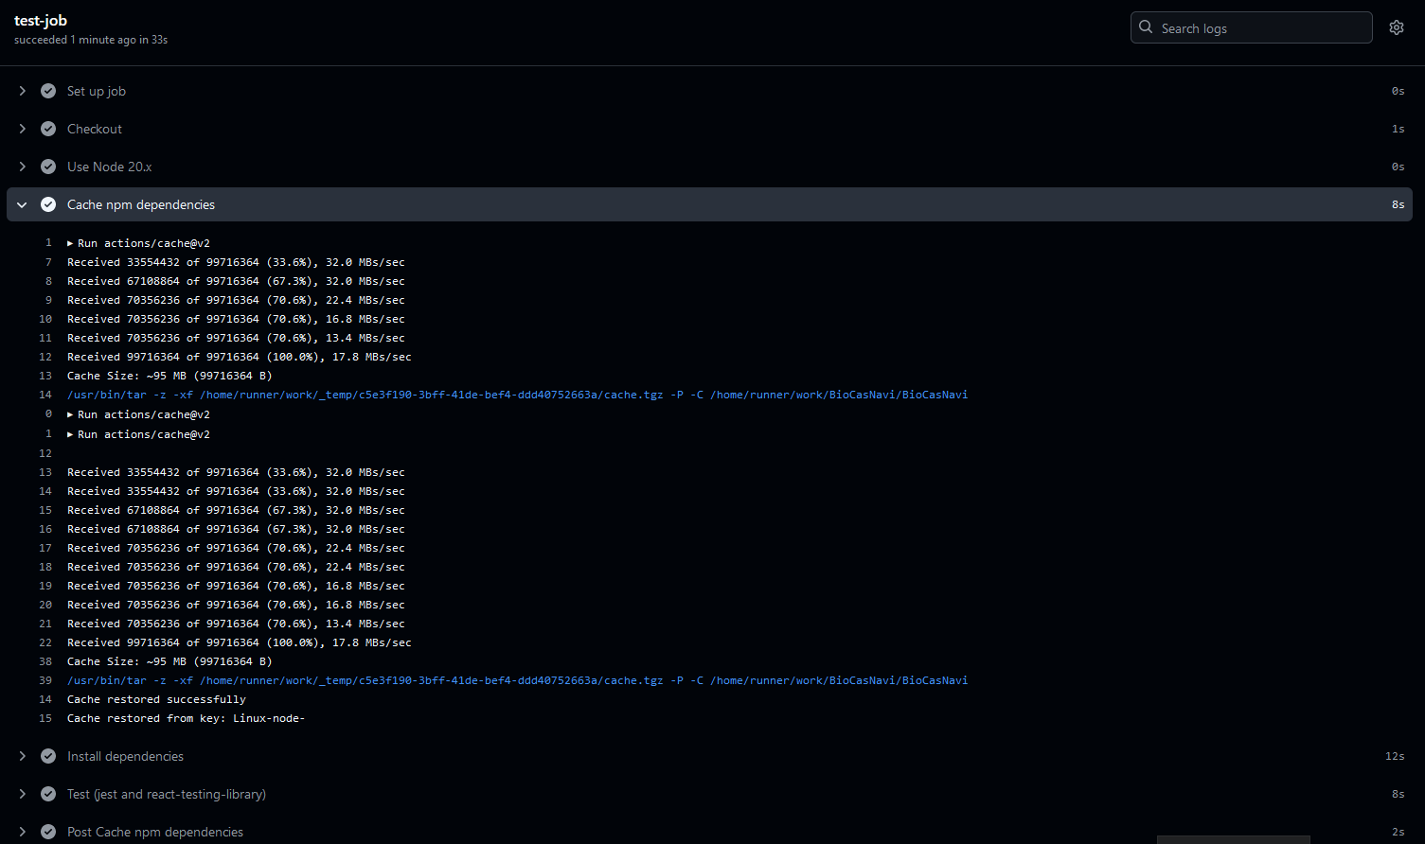
Sustainable software development / chapter 1
Github action - caching
Execution with cached dependencies
Workflow execution time : 33s vs. 3,6s
Execution without cached dependencies

Slide 33
Sustainable software development / chapter 1
Short introduction
I would like to thank
Prof. Ludger Wessjohann
Dr. Frank Broda
NWC department & Dr. Steffen Neumanns group

